Slide 1
Content Marketing For Tourism

Slide 2
What is content marketing and how does it work?

Slide 3
Content marketing is a strategic marketing approach focused on creating and distributing valuable, relevant, and consistent content to attract and retain a clearly-defined audience — and, ultimately, to drive profitable customer action.

Slide 4
What's in it for me?
Awareness
Builds relationships
Establish authority
Trust
SEO
Cost effective
Website traffic
Generates leads
Referrals

Slide 5
Before You Start…
Plan!
Know your audience segments
Research
Brainstorm content ideas
Understand the customer journey

Slide 6
Who do you want to attract?

Slide 7
Brainstorm!

Slide 8
Customer Journey: Time Together
“I want to…”
“What are my options?”
Research
“What will I do there?”
Decision
“Get a romantic weekend away”
“Where should I go…Fermanagh?”
“What is there for couples?”
“Where should I eat, stay, visit…?”
Book

Slide 9
The different types..
Blog
Video & Live Video
Articles
Whitepapers
Infographics
Webinars
Email
Ezines
Presentations
Ebooks
Podcasts
Apps
Games
Interactive Content
Images / graphics

Slide 10
What works?

Slide 13
It’s not all about you!

Slide 14
How can you add value to your audience?
Address a problem
Entertain
Make them laugh
Make them think
Challenge them
Spur an emotional response
Inform them
Help them
Treat them

Slide 15
Death of a Salesman
Top 3 reasons why people go online
To be entertained
To socialise
To learn stuff
NOT to be sold to!

Slide 16
Add value..
“Make me think,
make me laugh, inspire me,
or teach me something new,
And I’ll remember you when the time comes to buy.”
~What is Valuable Content and Why it Wins You Business

Slide 17
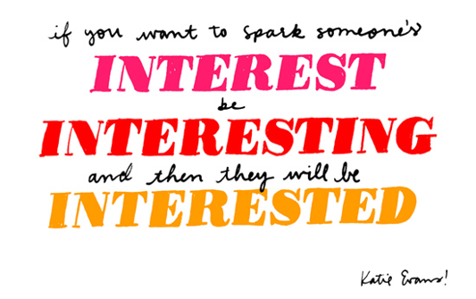

Slide 21
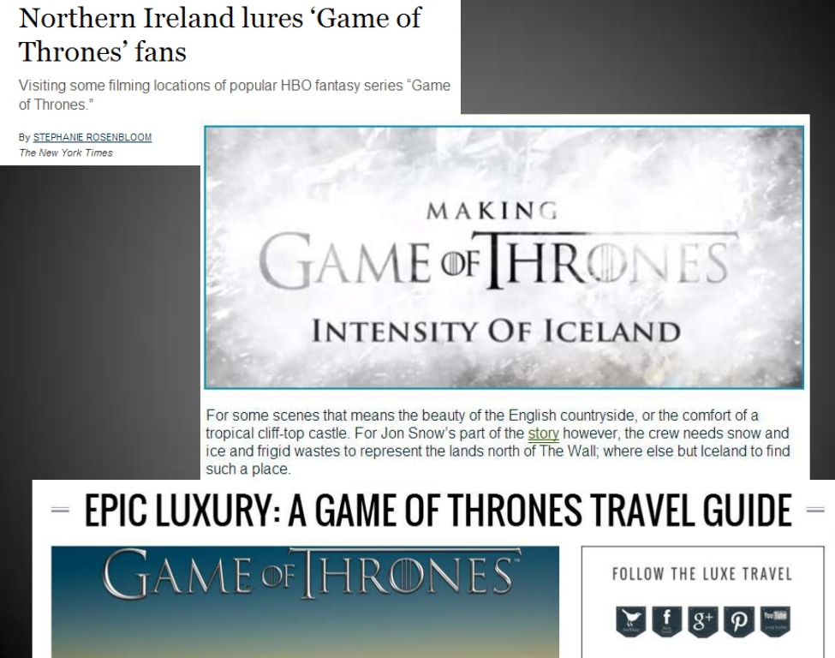

Slide 22
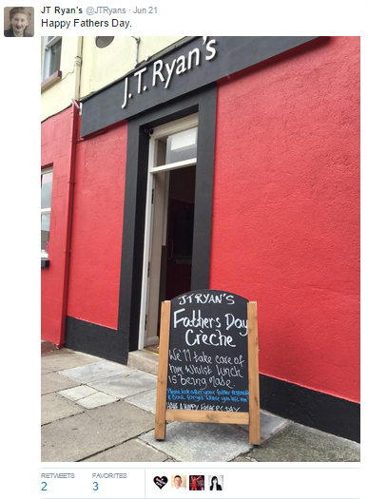
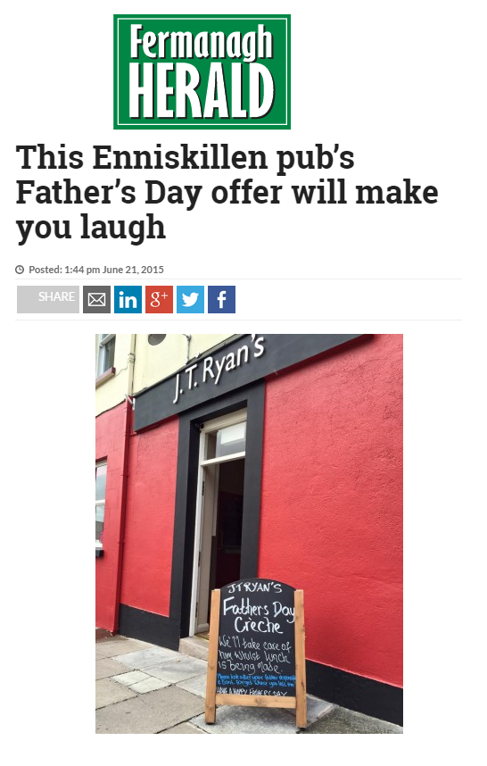
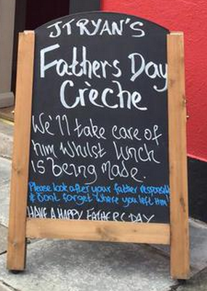

Slide 23
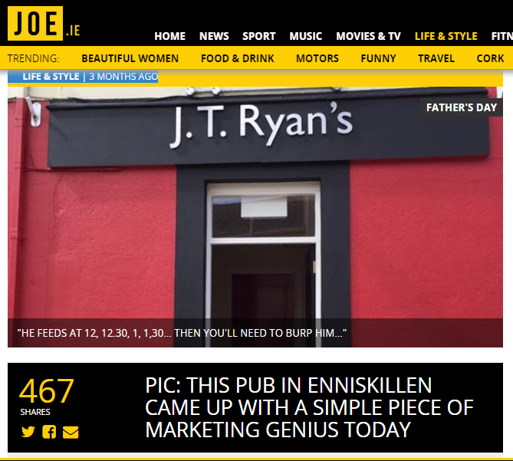
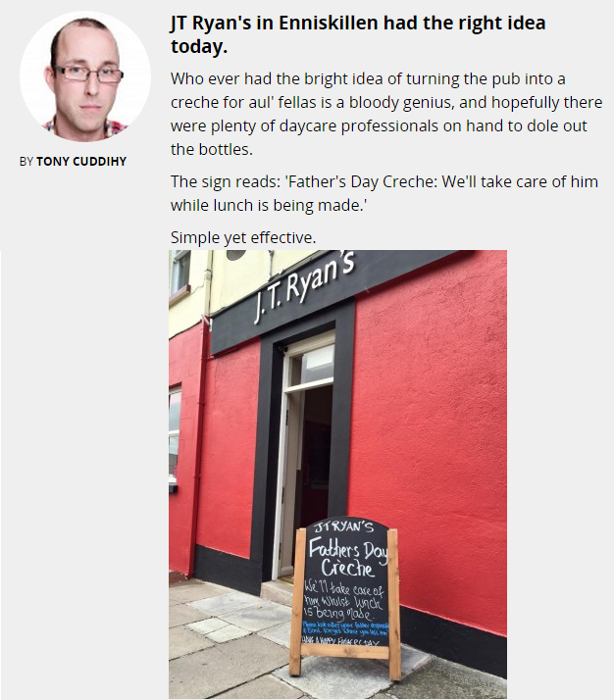
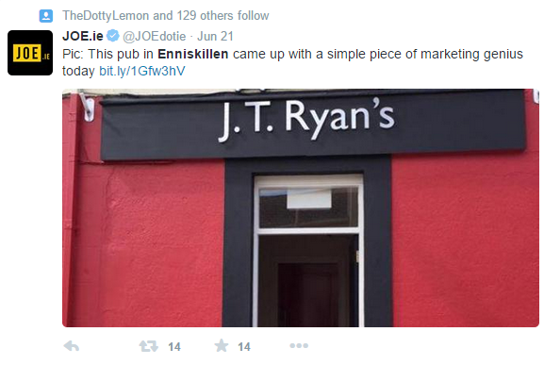

Slide 24
Most talked about in Ireland 2016

Slide 25
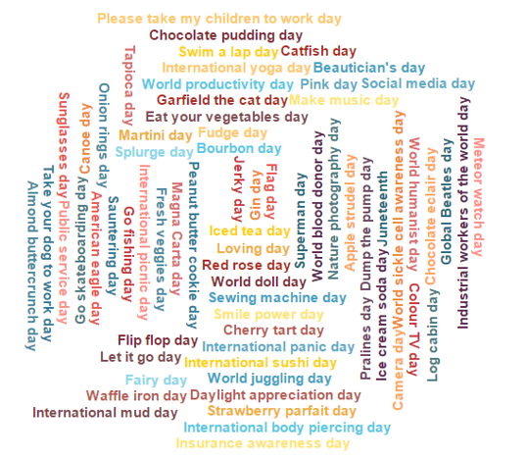

Slide 27
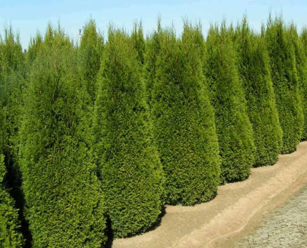
EVERGREEN

Slide 28
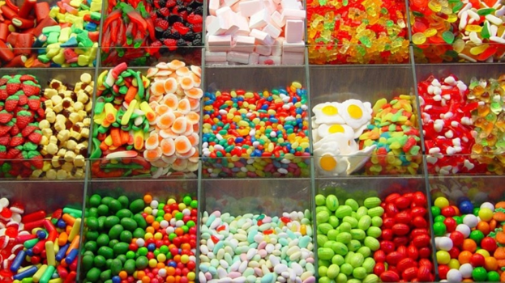
VARIED

Slide 29
READABLE
OR SCANNABLE

Slide 30
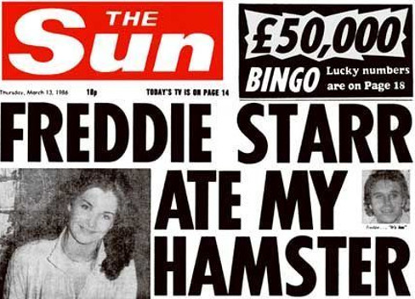
KILLER HEADLINE

Slide 31
Taps an Emotion

Slide 32
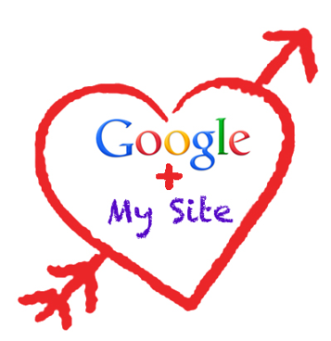
OPTIMISED​

Slide 33
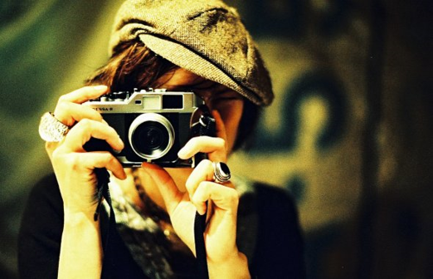
IS VISUAL

Slide 34
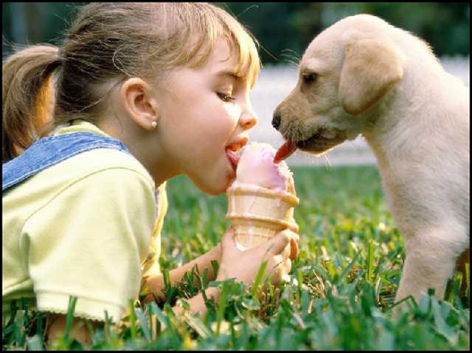
SHAREABLE

Slide 35
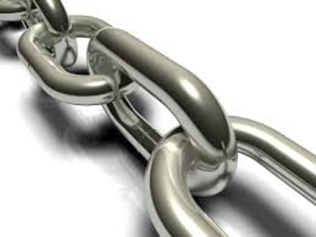
USES LINKS
AND ATTRACTS THEM​

Slide 36
TIMELY

Slide 37
PROMOTED

Slide 39
HAS A PLAN

Slide 40
USES CALLS TO ACTION

Slide 41
The Trends

Slide 42
Video

Slide 43
Video
360
Video Tours
https://www.facebook.com/pg/metmuseum/videos/

Slide 44
Video
Live
Local Events
Showcase the Area & the Attractions

Slide 45
Video
Brand storytelling
Share the experience
Behind the Scenes: Manager for a Day
https://www.facebook.com/irishcountryhotels/videos/vb.110798914179/10154618935079180/?type=2&theater

Slide 46
Simple Tools Are Effective
Created with Animoto

Slide 47
Make it Niche
Cork Convention Bureau showcased the city for hosting events, including testimonials
https://vimeo.com/119371708

Slide 48
Interactive Content

Slide 49
Interactive Content

Slide 50
Interactive Tourist Maps
Olympic Park, Montreal

Slide 51
Interactive Events Calendar
Quebec Festival

Slide 52
Interactive Maps
See http://epicenabled.blogspot.co.uk/2016_10_01_archive.html
Or http://www.czechpragueout.com/blog/2016/walk-through-old-town-in-prague
To create your own interactive map, check out https://mapme.com/

Slide 53
Interactive Video
http://www.goisrael.com/Tourism_Eng/Pages/Discover-Israel_Interactive-Movie.aspx
https://vimeo.com/71755749
Create your own interactive video, check out http://www.wirewax.com/

Slide 54
Interactive Quizzes
To create your own interactive quiz, check out Apester (http://apester.com/)

Slide 55
Blogging

Slide 56
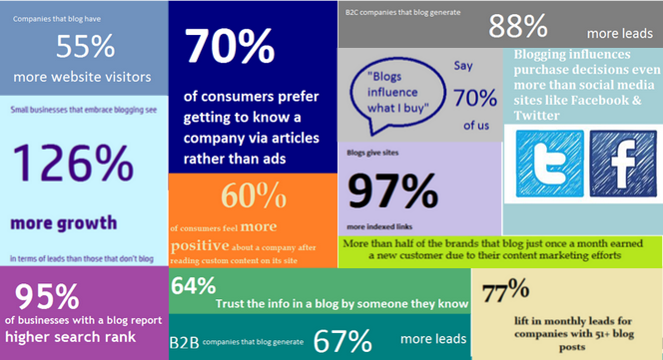

Slide 57
Where to get ideas

Slide 58
Your products / services
Questions you get asked & your own experience
Industry topics & Events
Benefits to your customer
Your brand – what do you stand for?
Events & seasons
What’s in the news?
Related products & services
Internet & Competitor Research

Slide 59
The List
“10 Romantic Things to Do in Fermanagh”
Interviews
“Barra Best Tells Us About His Experience on Lough Erne”
Reviews
“What do International Visitors Say About Omagh?”
What works?
“10 Resources for Planning Your Trip to Northern Ireland”
Links round-up
Controversial viewpoint
“Why You Shouldn’t Bring Your Kids on Holiday”
The process posts
“The step by step guide to planning your weekend break.”
News round-up
“What Brexit means for weekends across the border.”

Slide 60
Length Matters

Slide 61
Publish and Promotion

Slide 62
Content publishing
Think about your timing
The first people to see a blog post is likely to be those who have subscribed by email – when is the best time to have your post drop into their inbox?
When is the most suitable time for each social channel?
Make sure it’s shareable (have your social share buttons in place before publishing
Think about the tweeters – Is your headline going to work?

Slide 63
Content Promotion
Social Media
Publish on each of your different social media platforms, but not necessarily all at the same time or in the same format
Re-post as appropriate for each network
Target your audience and influencers
Schedule future posts for content which doesn’t age (or at least include it in your content calendar)
Spend time on your promotion!

Slide 64
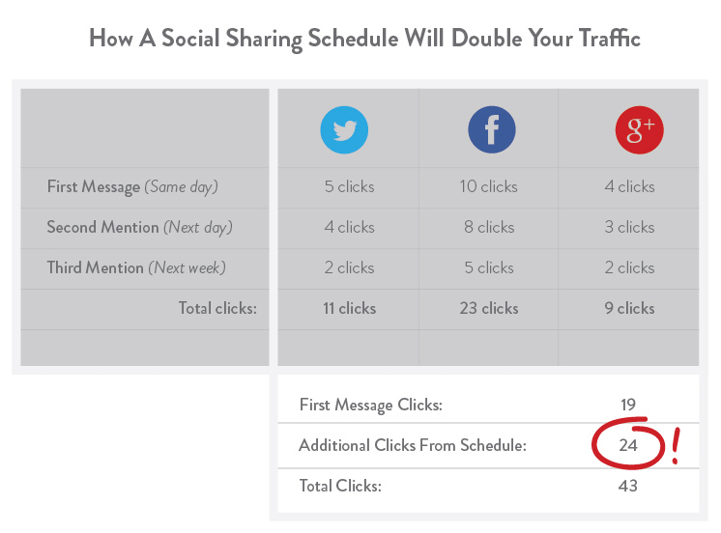
Re-sharing can increase traffic
Source: Kissmetrics

Slide 65
Consider..
Appropriate hashtags
Influencers you’d like to target
Keywords your audience might search for
Timing of each share
Using different post content to test what works best

Slide 66
Content Promotion Tools
Promote your content on other websites
Audience targeting available
Massive audience potential
Check out Taboola & Outbrain
PPC Model

Slide 67
Useful Resources
Snagit / Screenhunter – or another screen capture tool to capture images
Hootsuite / Buffer – for scheduling your content promotion on different social media platforms
PicMonkey, Canva.com
Sulia Splash – to create animated GIFs
Infagraph / Easel.ly – to create infographics
Powtown – Animated video maker
Wordpress - Blogging
Podcasts: http://edtechreview.in/news/533-free-tools-to-create-podcasts
Content Curation: Pocket, Twitter Lists, ScoopIt, RebelMouse
Video: Camtasia, Nutshell, Powtoon, Stupeflix, Animoto, Videoshop, iMovie, Magisto, Distill / Pexels (Video Library), Windows Movie Maker
To find influencers: Followerwonk

Slide 68
Brainstorm!

Slide 69
Questions?
UtterDigital.com

